Slide 1
IAQ Problem Prevention
NH Health Officer’s Association
Spring Conference
May 25, 2011
Phil Alexakos, MPH, REHS
Chief of Environmental Health and Emergency Preparedness
Manchester Health Department

Slide 2
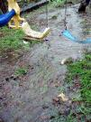
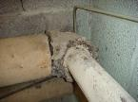
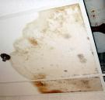
Mold Prevention
Moisture, Moisture, Moisture!!!!!

Slide 3
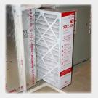
Routine Maintenance
Filter Changes
Frequency
MERV rating vs. Air Flow
Ceiling Tiles
Water staining
Old or New??
Missing and Why?

Slide 4
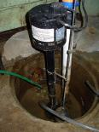
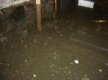
Routine Maintenance
Plumbing Fixture Leaks
Condenser Drip Pans
Water infiltration
Ground (sumps)
Door sweeps
Walls
Below Grade Spaces!!

Slide 5
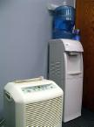
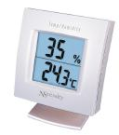
Best Practices
Control Moisture
Humidity
Must be less than 60 %
Ideally between 30-50%
Exterior Grading
Water should be directed away from the building
Temperature Contrast
Poor insulation, venting

Slide 6
Best Practices
Control Temperature
ASHRAE STANDARD 55-1981 Thermal Environmental Conditions for Human Occupancy
Relative Humidity | Winter temperatures ^{O} F | Summer temperatures ^{O} F
30% | 68.5-76.0 | 74.0-80.0
40% | 68.5-75.5 | 73.5-79.5
50% | 68.5-74.5 | 73.0-79.0

Slide 7
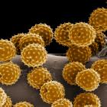
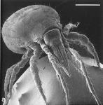
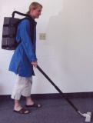
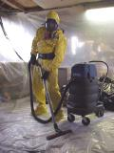
Best Practices
Control Spores
Door Mats
HEPA Filtration Vacuuming
Carpet Assessment
Wet?
Fraying

Slide 8
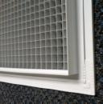
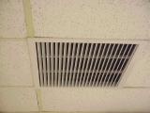
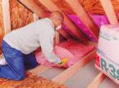
Best Practices
Assess HVAC system at least quarterly
Returns and Exhaust are unobstructed
Check duct work and insulation for moisture
Assure that moisture producing equipment is vented
Dishwashers etc.

Slide 9
Best Practices
Staff should be encouraged to report any signs of water damage
Time is of the Essence
After 48 Hours the Hazards Increase

Slide 10
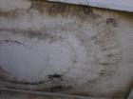
Visible Mold
Remove the Source of Moisture!!
If you just treat the surface or paint over it…
I’ll BE BACK!!

Slide 11
Questions & Answers

