Slide 1
Bed Bugs in the Community
Philip J. Alexakos, MPH, REHS
Manchester Health Department
Environmental Health Division

Slide 2
What are they?
Parasites related to Lice
Reddish-brown, oval-shaped, flattened insects about the size of a tick
Non-disease vectors
Feed off the blood of humans

Slide 4
History
Many references to them in historical literature
“Red Coat Bugs”
Widely eradicated in developed countries after the use of DDT and other toxic pesticides
Resurgence due to restriction of such chemicals and ease of travel

Slide 5
Where are they found?
Apartments, homes, shelters, hotels, dormitories, laundromats, etc.
Live in cracks or crevices where people sit or sleep for long periods of time

Slide 6
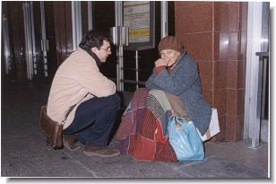
Who Can Get Bitten?
Everyone regardless of age, sanitation or class!

Slide 7
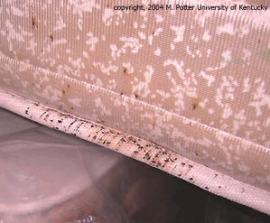
How Are They Detected?
Blood-stained Smears on Bedding, Walls, Curtains
Usually Only Come Out at Night
Hiding in Picture Frames, Bedding, Window Frames, Carpets or Walls

Slide 10
What do the Bites Look Like?
Relatively Painless
Reddish
Raised
Itchy

Slide 11
Prevention and Control

Slide 12
Special Precautions
Furniture or Bedding on the Side of the Road or at Trash Collection Sites
Used Furniture or Bedding
Community Laundromats
Furnished Apartments
Hotels and Motels

Slide 13
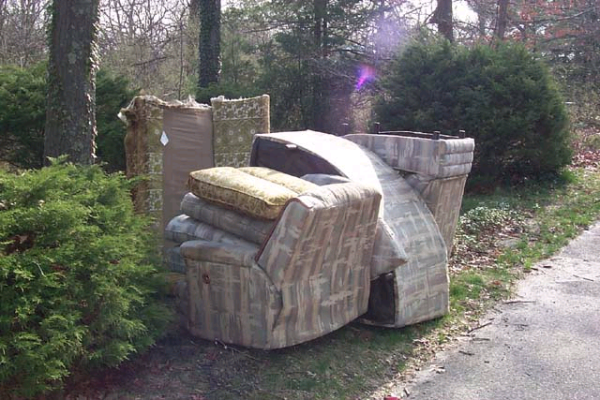

Slide 14
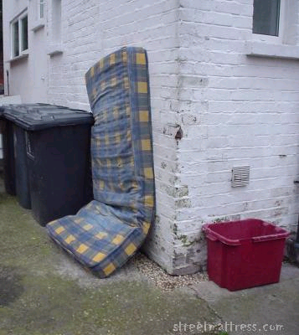
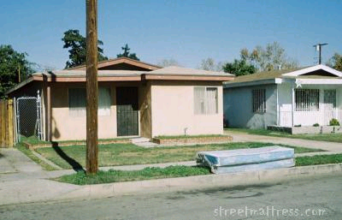

Slide 15
What Should You Do If You Think Someone Has Bed Bugs?
Encourage them to contact the property owner
The sooner you address the problem the better chance you have to successfully eliminate it
Contact the local health officer and/or code enforcement official to make an offical complaint
Depends on local ordinances and State codes/RSA’s

Slide 16
What Should You Do If You Think Someone Has Bed Bugs?
Advise them to avoid using over-the-counter pesticides (such as ‘Raid’) especially in areas occupied by children/infants or people with respiratory disorders
Not effective
Misuse and toxicity
Contact a licensed Pest Control Operator (PCO)
Ask for references
Have they been successful in treating them

Slide 17
What Should You Do If You Think Someone Has Bed Bugs?
Tenants need to work together with property owners and PCO’s!!!!
Proper treatment preparation
Laundering
Vacuuming
Bed covers
Removal of untreatable items
Eliminating use of unchecked used furniture etc.

Slide 18
What Should You Do If You Think Someone Has Bed Bugs?
Key Facts
Successful eradication may require multiple chemical/heat treatments
Ongoing monitoring is essential
One “bad” tenant in a multi-family will ruin the effort
Need to provide tenants with easy to use instructions and resources to handle their end of the bargain……

Slide 19
Multi-Agency Pest Control Effort
Langdon Mill Campaign
20 unit apartment building
50 residents
Relocated for 2 weeks
Ongoing education and surveillance
Spring/Summer/Fall 2009 and Ongoing

Slide 20
Who was Involved? Part 1
Property Owner
Community Organizers
Granite State Organizing Project
American Friends Service Committee
Local Government
Manchester Health, Public Works, Building and School Departments, and Mayor’s Office
Academic Institutions
St. Anselm College

Slide 21
Who was Involved? Part 2
Faith Based Organizations
Manchester Church of God
Community Advocacy Groups
Greater Manchester Association of Social Service Agencies (GMASA)
United Way
Local Businesses
Wal Mart

Slide 22
Lessons Learned
Waiting too long makes an infestation impossible to completely eradicate
Active surveillance continues
Quick response to new sightings
Must be a carefully coordinated effort
Must have the support of the property owner and ALL tenants
Pick up of infested materials must be timely
Education and ongoing assessments are a must

Slide 23
Lessons Learned
Must identify barriers to success
Languages and Literacy
$$$
New or “gently used” replacement items
Laundry
Relocation
New Tenants
Reducing the “stigma” of reporting

Slide 24
Now What…
Bedbug Policy Task Force
Policy Change
Reducing risk factors
Curbside bedding/furniture pick-up
Addressing areas of concern
Used furniture and clothing operations
Increase funding to treat/support treatment
Public Education
Increase access to educational materials
Reduce stigma

Slide 25
Referral Information
Manchester Health Department
624-6466
palexako@manchesternh.gov

