Slide 1
NH Health Officers Association Spring Workshop May 22, 2019 Sarah MacGregor, President

Slide 2
Dragon and the Dragon Queen
Dragon Mosquito Control, Inc. specializes in the development and implementation of Integrated Mosquito Management (IMM) programs for New Hampshire communities.
Our programs are designed to control disease vector mosquitoes and nuisance mosquitoes while promoting environmental health.
Bug Lady- studying entomology at UNH
Mosquito Lady- working in mosquito control
Dragon Lady- formed Dragon Mosquito Control Inc. in 1989
Dragon Queen- more than 30 years of providing gold standard mosquito control in Southeastern NH

Slide 3
2019 Municipalities

Slide 4
New Hampshire Mosquitoes and Ticks
Mosquitoes – are a vector for the transmission of dozens of diseases worldwide. Three diseases are currently a concern in NH. Mosquitoes kill more people than any other animal: over 700,000 each year
Mosquito season in New Hampshire lasts from May through the fall until a hard freeze
Ticks - five major tick-borne diseases are spread by four tick species in New Hampshire.
Tick season in New Hampshire begins in March and lasts into November
Notes:
Tick-borne disease in NH Anaplasmosis, Babesiosis, Ehrlichiosis, Lyme disease, Powassan encephalitis

Slide 5
Mosquito-borne Disease in NH Mosquitoes
Eastern Equine Encephalitis- deadliest arbovirus in the North America
West Nile Virus- increased disease activity in New Hampshire, Massachusetts, Vermont and Maine in 2018
Jamestown Canyon Virus-NH had 4 human cases in 2017
ZIKA-We continue trapping for ZIKA mosquitoes

Slide 7
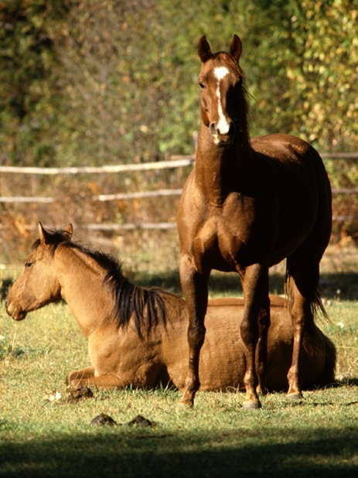
EEE LOOKING BACK
In the 60’s, 70’s & early 80’s EEE was widespread
Nothing for two decades
2004 EEE reemerges after 22 years

Slide 8
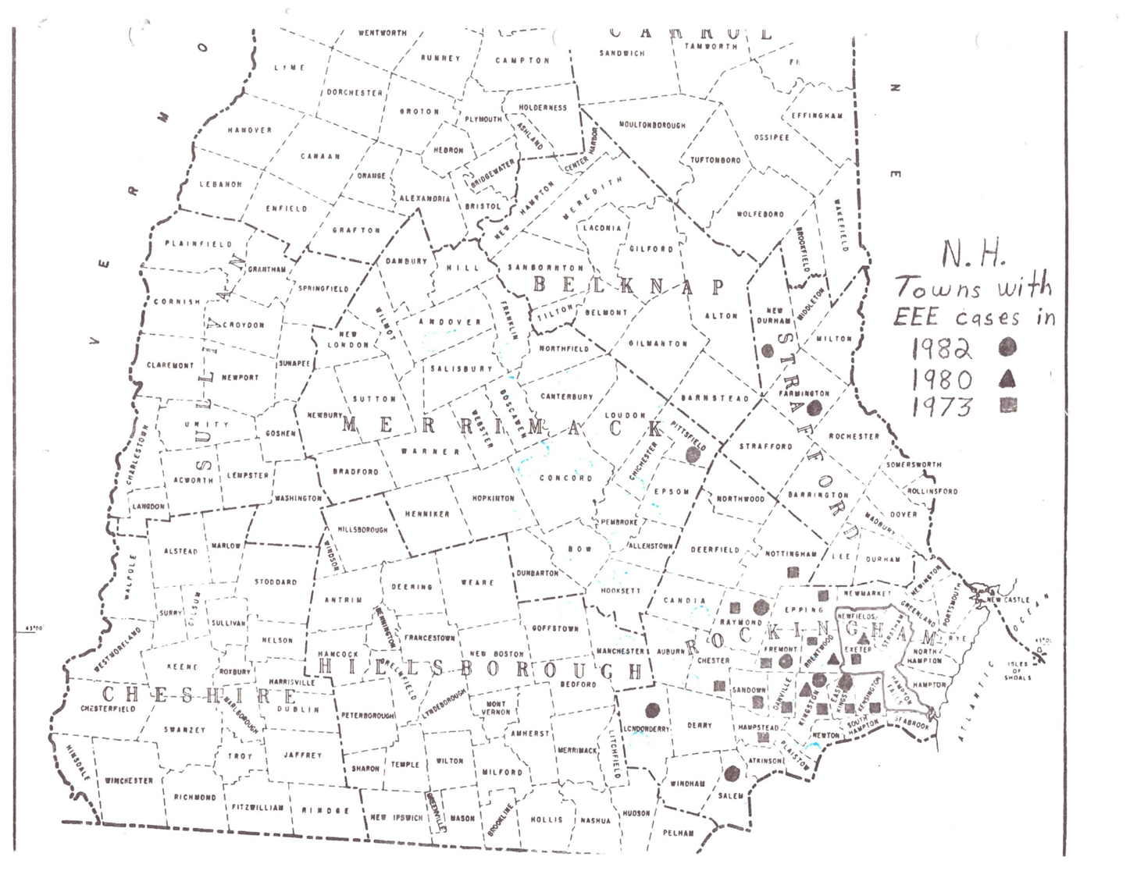

Slide 9
EEE 2005
21 cases reported (8 deaths)
New Hampshire: 7 (2 deaths)
Florida: 5 (3 deaths)
Massachusetts: 4 (2 deaths)
Alabama: 2 (1 death)
South Carolina: 1 (0 deaths)
Georgia: 1 (0 deaths)
Louisiana: 1 (0 deaths)

Slide 10
NH Arboviral Risk Map 2018

Slide 11
NH EEE Serosurvey

Slide 12
Eastern Equine Encephalitis Activity 2018
Newton MEL 9-13-18
Sandown MEL 9-18-18
Newton MEL 9-20-18
Manchester MEL 9-25-18
Newton MEL 9-27-18
Rye MEL 9-27-18

Slide 14
West Nile Virus
First found in NH in 2000, the occurrence and spread of West Nile Virus may be the first in a series of exotic diseases imported due to the global increase in international travel and trade and climate change
New Hampshire was the only state in the U.S. in 2018 without a human case of WNV.

Slide 15
WNV 2018
NH- 32 mosquito samples tested positive
4 animal cases (birds)
No human cases
MA- 579 mosquito samples tested positive
2 animal cases (horse & alpaca)
49 human cases
ME- 4 mosquito samples tested positive
1 animal cases (horse)
2 human cases
VT- 157 mosquito samples tested positive
4 animal cases (horses & birds)
1 human case

Slide 16
West Nile Virus NH
Manchester PIP 7-16-18
Manchester PIP 8-7-18
Salem PER 8-9-18
Manchester PER 8-13-18
Manchester PIP 8-13-18
Manchester CIN 8-13-18
Manchester PIP 8-14-18
Nashua PIP 8-16-18
Keene SAL 8-16-18
Manchester PIP 8-20-18
Manchester CAN 8-22-18
Manchester PFR 8-22-18
No. Hampton PIP 8-28-18
Rye SAL 8-28-18
Nashua PIP 8-30-18
Nashua PIP 8-30-18
Londonderry SAL 9-4-18
Manchester PER 910-18
Londonderry SAL 9-11-18
Raymond MEL 9-11-18
Candia MEL 9-11-18
Candia MEL 9-11-18
Candia CIN 9-11-18
Sandown MEL 9-11-18
Kingston RES 9-13-18
Newton MEL 9-13-18
Portsmouth MEL 9-18-18
Rye MEL 9-18-18
Rye SAL 9-18-18
Kensington RES 9-18-18
Keene PIP 9-27-18
Newton MEL 10-4-18

Slide 17
Jamestown Canyon Virus
First found in 1961 in Colorado
Considered a rare emerging disease
Amplification host White-tailed Deer
Sudden onset of flu-like symptoms with a fever
Onset April to September
Majority of cases have been in males
Median age of 48
Humans are dead end hosts

Slide 18
Jamestown Canyon Virus
U.S.-166 cases detected from 2004-2018
NH - First detected in 2013
Seven cases of JCV and one Death in NH
May be spread by 26 species of Mosquitoes
Under recognized

Slide 19
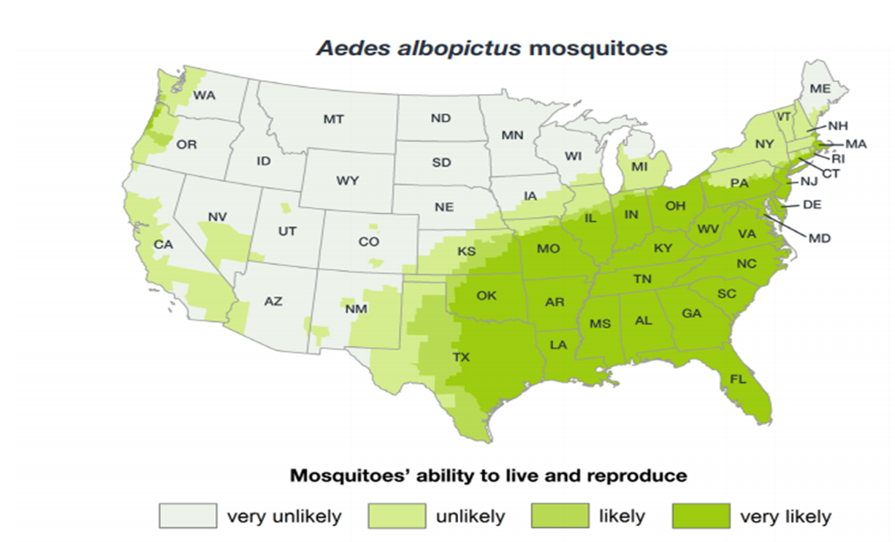
ZIKA
2015 Detected in New Hampshire resident
Currently the mosquitoes that are responsible for spreading ZIKA are not established in NH

Slide 20
ZIKA mosquito, Aedes albopictus established in Massachusetts

Slide 21
Preventing Mosquito-borne Disease
Community options
Personal options
Inform the public about the risks and ways to prevent mosquito bites
Secure a Special Permit and be ready to act in an emergency
Implement a surveillance program
Implement a comprehensive mosquito control program
Prevent mosquito bites
Use EPA registered repellent
Avoid exposure at dawn and dusk when mosquitoes are most active
Dump standing water weekly throughout the mosquito season

Slide 22
What doesn’t work
Bug Zappers: These kill thousands of insects every day. Two independent studies found that mosquitoes comprised only 4-6.4% of daily catches during the season with no significant reduction of mosquitoes in yards. Non-pest insects made up the majority of the catches including vast number of beneficial insects. In addition, mosquitoes are more attracted to humans than the device.
Ultrasonic Devices: At least 10 studies in the past 15 years have denounced ultrasonic devices as having no repellency value whatsoever. Yet, consumers flock to stores to purchase these contraptions.
Bats: Food items identified in their diet are primarily beetles, wasps, and moths. Mosquitoes have comprised less than 1% of gut contents of wild caught bats in all studies to date. A moth provides much more nutritional value per capture than a mosquito. White nose syndrome is fatal to several species of hibernating bats, and several species have declined by nearly 99% in New Hampshire.
Purple Martins: The purple martins diet includes many types of insects other than mosquitoes, but this appears to have been lost on many individuals searching for a natural means of control. In fact, during daylight, purple martins often feed voraciously upon dragonflies, known predators of mosquitoes. In the evening, when mosquitoes are most active, purple martins tend to feed at treetop level, well above most mosquito flight paths.

Slide 23
Special Permits required for municipal programs Permit process will take months Submit application in Jan - Feb Reviewed by six State Agencies

Slide 24
Bees

Slide 25
Surveying and Larviciding

Slide 26
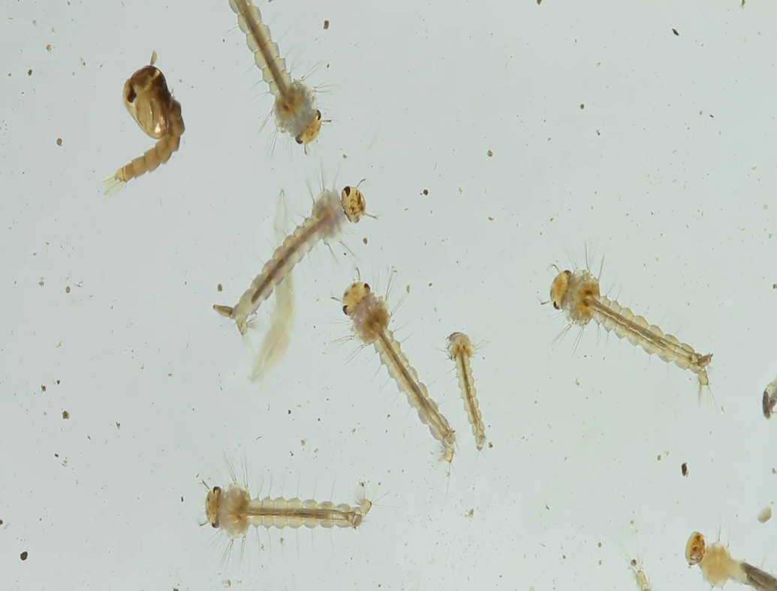
Mosquito Larvae & Pupae

Slide 27
Catch Basin Mosquitoes
Storm drain, https://en.wikipedia.org/w/index.php?title=Storm_drain&oldid=888354115 (last visited May 21, 2019).

Slide 28
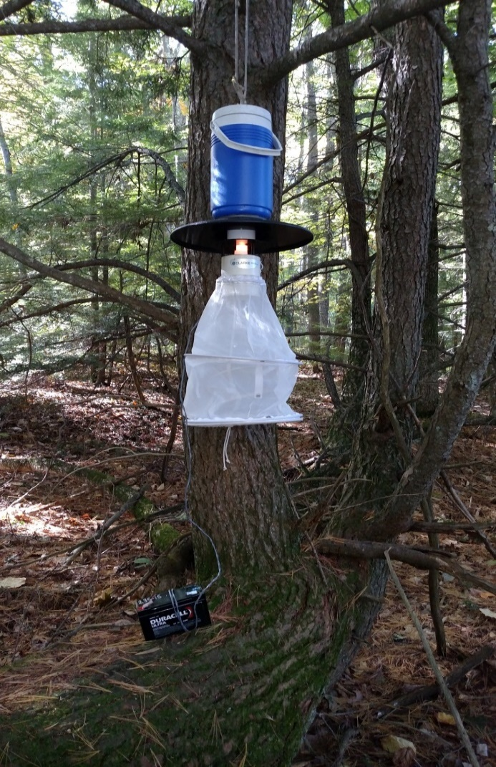
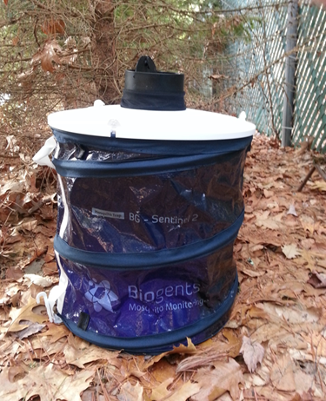
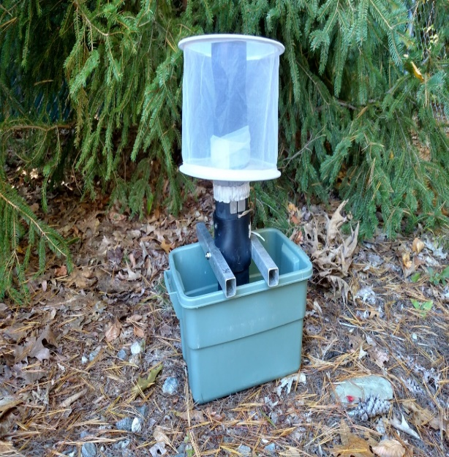
Surveillance
Traps set out and retrieved weekly
Mosquitoes identified to species
State Lab tests for disease

Slide 29
Light Trap Catch

Slide 30
Mosquitoes identified to Species
Samples sent to the State Lab for Testing

Slide 31
Adulticiding by Backpack

Slide 32
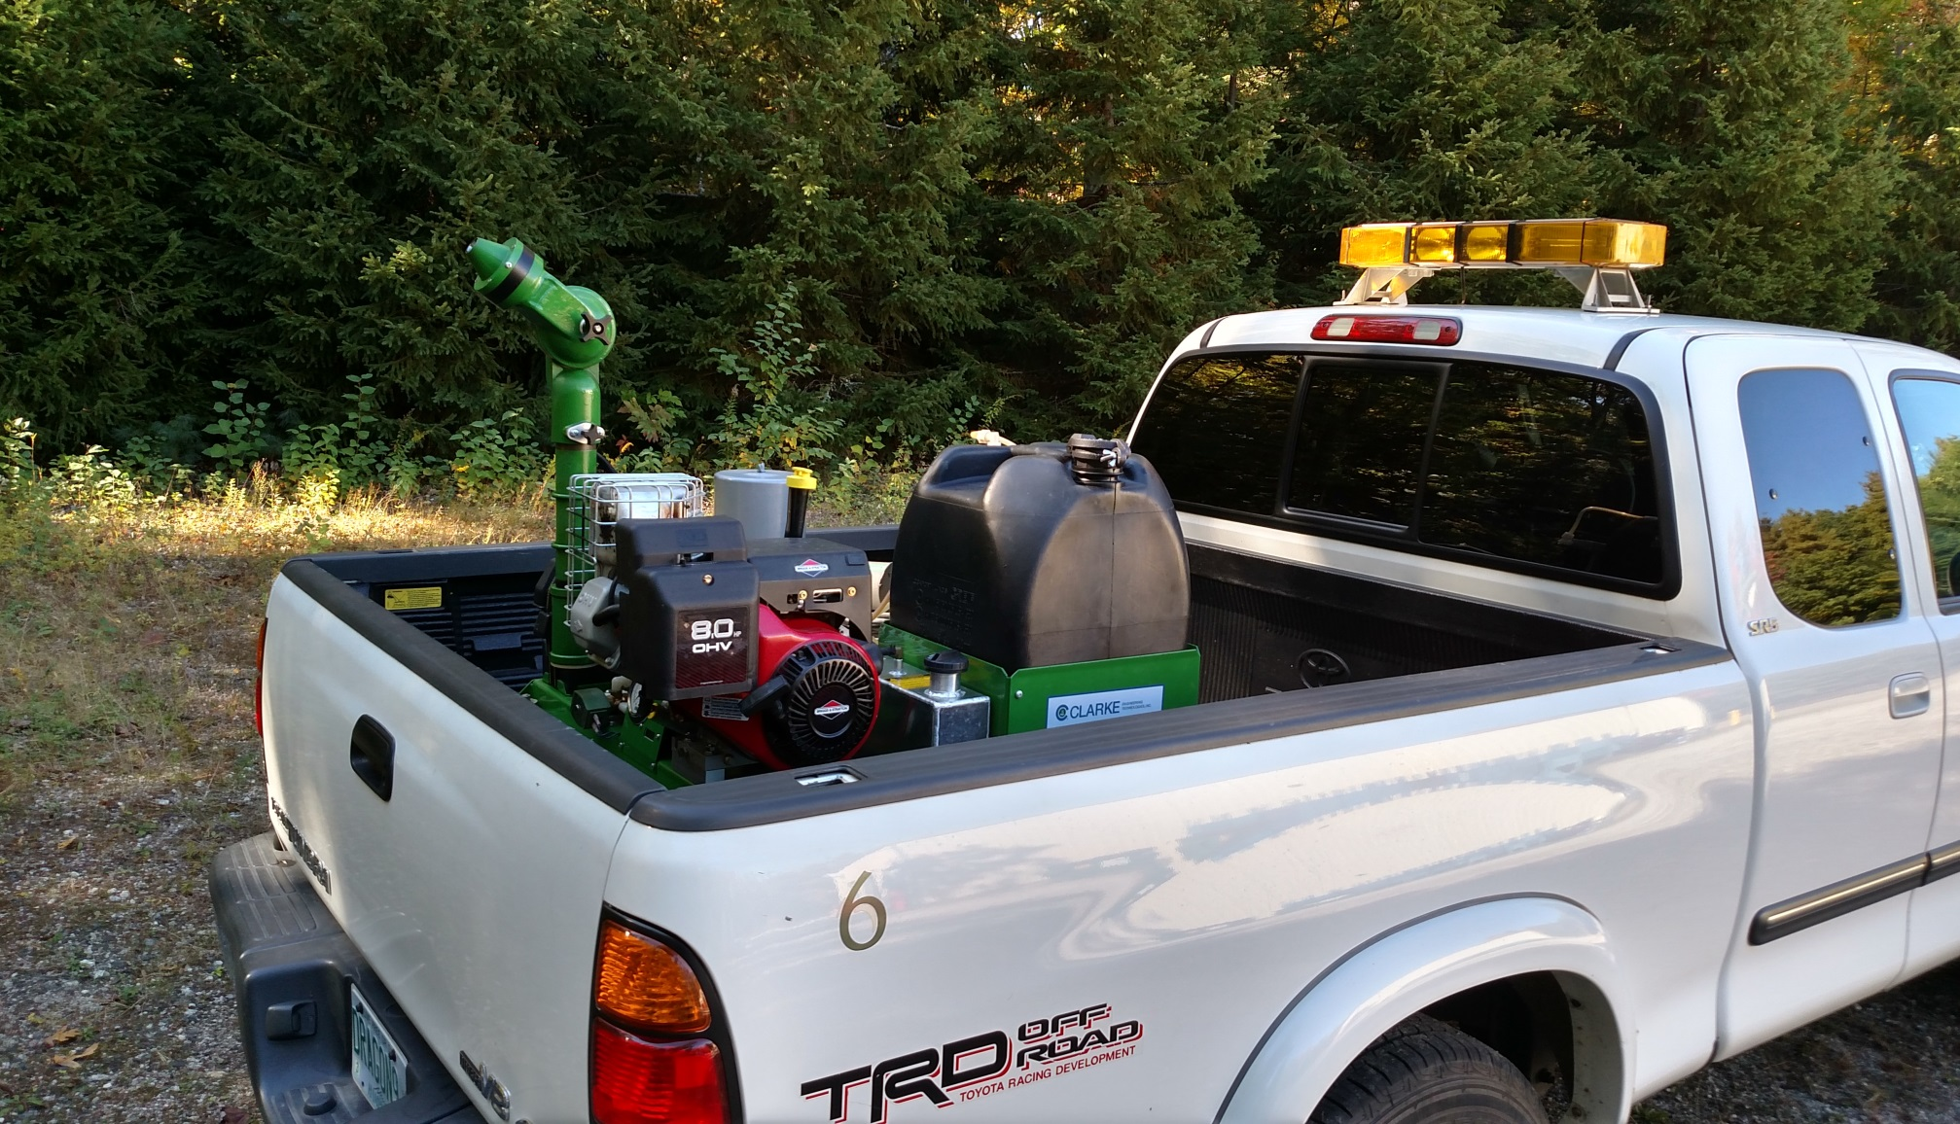
Adulticiding by Truck

Slide 33
Truck Spraying for Adult Mosquitoes

Slide 34
Tick-borne Disease
Over the past two decades, seven new tick-borne pathogens that can cause illness have been identified in the United States
In 2017, state and local health departments reported a record number of cases of tick-borne diseases to CDC.
Reported cases capture only a fraction of the overall number of people with tick-borne illnesses.
The number of counties in the northeastern and upper Midwestern United States that are considered high-risk for Lyme disease increased by more than 300% between 1993 and 2012.
www.cdc.gov/media/dpk/diseases-and-conditions/lyme-disease/index.html
Notes:
Borrelia mayonii, Borrelia miyamotoi, Ehrlichia ewingii, Ehrlichia muris eauclairensis, Heartland virus, Rickettsia parkeri, and Rickettsia species 364D.

Slide 35
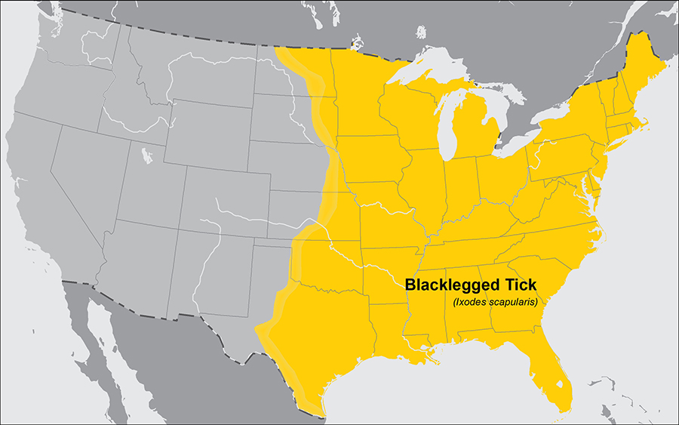
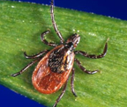
Black-legged Ticks
Anaplasmosis
Babesiosis
Borrelia miyamotoi disease
Ehrlichiosis
Lyme disease
Powassan encephalitis
cdc.gov/ticks/geographic_distribution.html
Notes:
Powassan has seen an uptick in disease cases- human cases tripled in 15 years

Slide 36
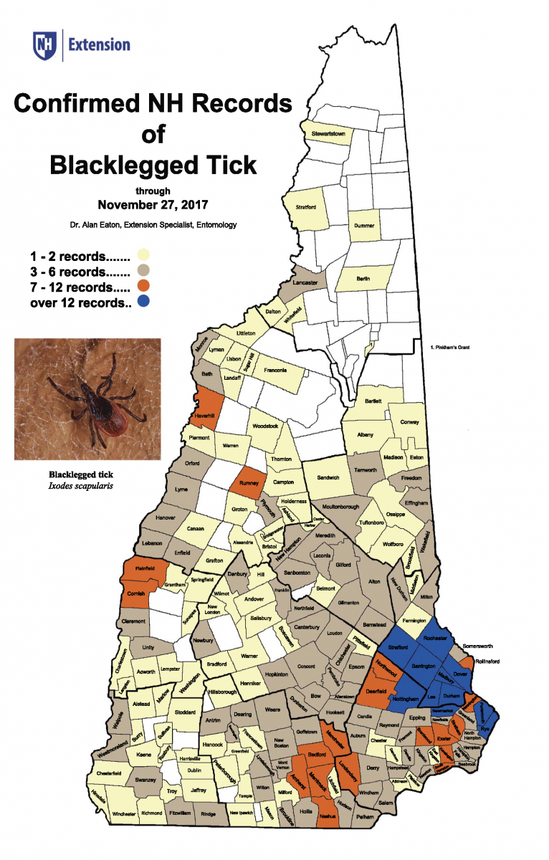
Black-legged Ticks
extension.unh.edu/resource/biology-and-management-ticks-new-hampshire-fact-sheet

Slide 37
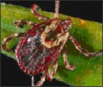
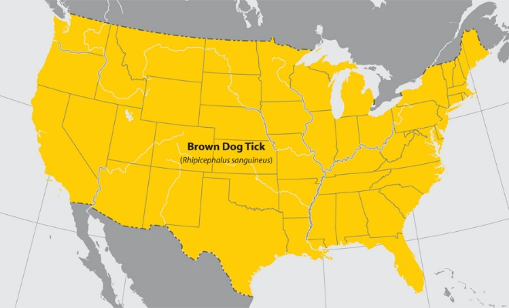
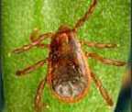
American Dog Tick
Rocky Mountain spotted fever
Tick Paralysis
Tularemia
Rocky Mountain spotted fever
Brown Dog Tick
cdc.gov/ticks/geographic_distribution.html

Slide 38
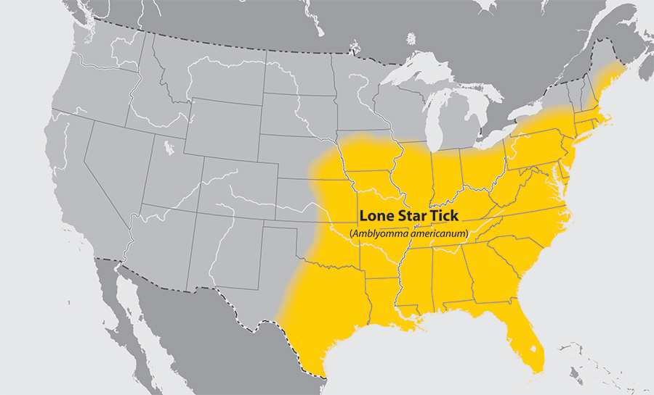
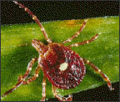
Lone Star Tick
Ehrlichiosis
Tularemia
Heartland Virus
Bite may be linked to meat allergy
cdc.gov/ticks/geographic_distribution.html

Slide 39
Asian Longhorned Tick
Reported for the first time in the United States in 2017.
In other countries, bites from these ticks can make people and animals seriously ill. As of March 25, 2019, no harmful pathogens have been found in the ticks collected in the United States. Research is ongoing.
As of March 11, 2019, Asian Longhorned ticks have been found in AR, CT, KY, MD, NC, NJ, NY, PA, VA, and WV
www.cdc.gov/ticks/longhorned-tick
Notes:
Asian Longhorned tick came to NH on a dog retuning from NY

Slide 40
Preventing Tick-borne Disease
Treat your clothing and gear with 0.5% Permethrin
Use EPA registered insect repellent
Avoid tall grassy areas and walk in the middle of trails
Check your clothing for ticks
Examine your gear and pets
Shower soon after being out side
Check your skin and scalp for ticks
Tick Management Handbook available on the CDC website
Create a tick free zone in your yard
Use pesticides to reduce the number of ticks in your yard
Follow the label
Spray in the evening and avoid spraying flowers to protect bees
If you have your yard sprayed by professionals, educate yourself on the products and methods they are using
www.cdc.gov/ticks/avoid/index.html

Slide 41
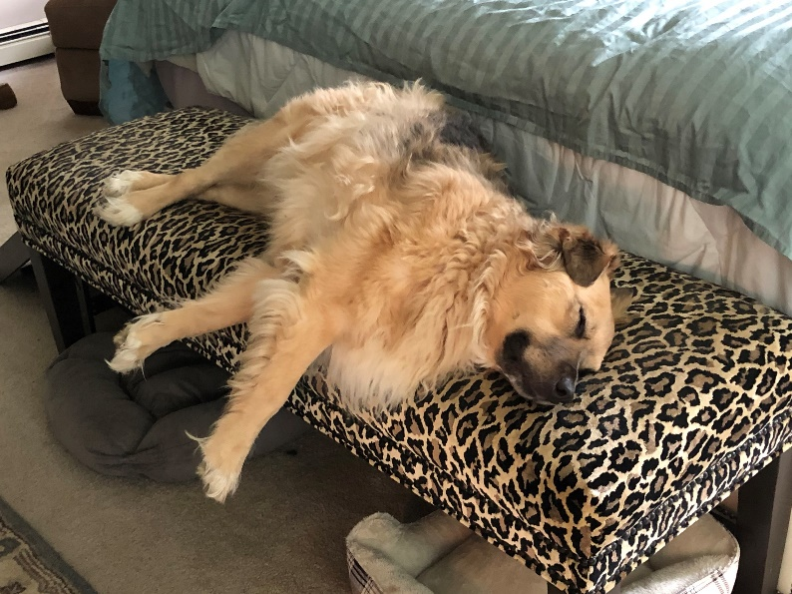
Dogs and Ticks
The most important tick-borne diseases that affect dogs are Lyme disease, Ehrlichiosis, Anaplasmosis, Rocky Mountain Spotted Fever and Babesiosis
All can have serious health consequences for dogs
Use a veterinary approved tick prevention
Vaccines are available for Lyme
Regularly inspect your dog
Remove ticks quickly

Slide 42
Reasons for Increased Disease Activity
Climate Change
Land use changes
El Niño
Virus Mutation
Crowded Living Conditions
Increase Global Travel
Smaller World
Ecotourism
Poverty

Slide 43
Looking Forward
There’s potential for a strong start to the West Nile Virus season in 2019
What’s up with Jamestown Canyon Virus?
Is there more Eastern Equine Encephalitis in our future?
Other mosquito borne diseases on the horizon: Usutu Virus, Rift Valley Fever and Yellow Fever
Notes:
Usutu- widespread in Europe, killing birds, vector- Culex pipiens Rift Valley- epizootic outbreaks of RVF increase the likelihood of contact between diseased animals and humans, which can lead to epidemics of RVF in humans. Yellow Fever- current outbreak in Brazil

Slide 44
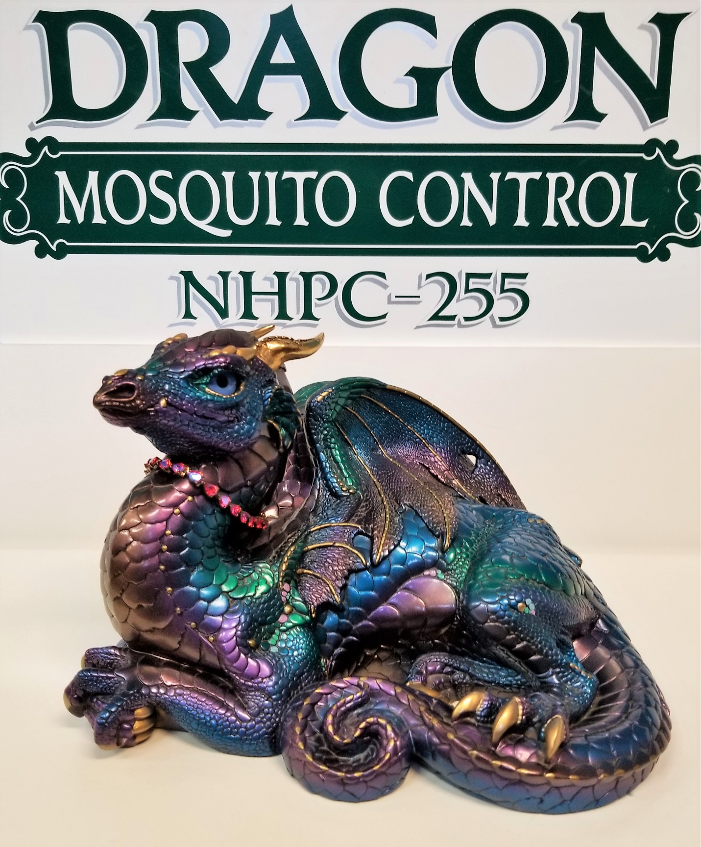
2019 Happy 30th Birthday

Slide 45
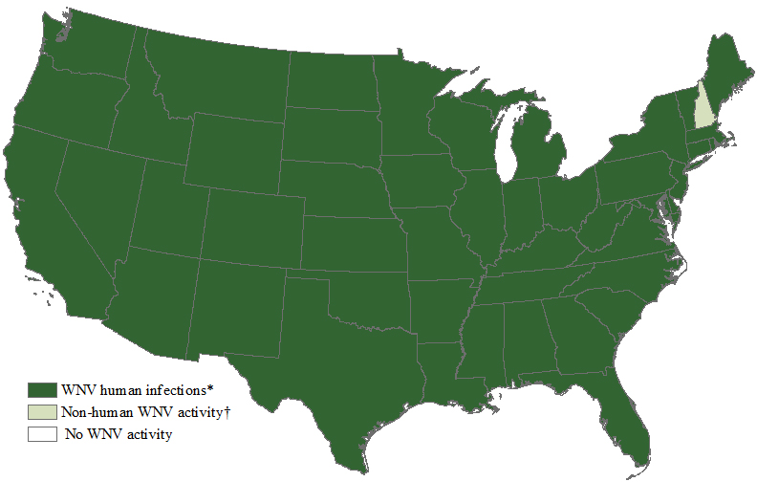
Questions?
Dragon Mosquito Control, Inc.
www.dragonmosquito.com
Phone: 603-734-4144

