Slide 1
Substance Use Disorder: Connections to Treatment
Lindy Keller, MLADC, MS NH Bureau of Drug & Alcohol Services Lindy.Keller@dhhs.nh.gov

Slide 2
Agenda
Variety of available substance use disorder (SUD) services
How someone can access services
How to raise the topic and refer someone

Slide 3
SUD Evaluation
Diagnosis
Severity
COD or confounding issues
Readiness
Level of care

Slide 4
Levels of Care for SUD Treatment
Withdrawal Management
Early Intervention
Outpatient Services
Intensive Outpatient/Partial Hospitalization
Residential Services
Medication Assisted Treatment

Slide 5
Medication -Assisted Treatment (MAT)
Medication addresses neurobiology, physical
Counseling addresses mental, emotional, social, spiritual
Case management ensures coordination
MAT Guidelines: http://www.dhhs.nh.gov/dcbcs/bdas/documents/matguidancedoc.pdf

Slide 6
MAT Occurs In
Addiction treatment programs
Opiate treatment programs
MAT clinics
Medical Providers
Federally Qualified Health Centers
Primary Care
OB-GYN
Pain Clinics

Slide 7
Recovery Supports
Mutual Support Groups
12-step programs
SMART Recovery
On-line groups
Faith-based programs
Residential recovery centers
Recovery Community Organizations / Recovery Centers

Slide 8
Recovery Community Organizations
Greater Tilton Area Family Resource Center: Tilton
Hope for NH Recovery: Manchester & Berlin
Keene Serenity Center: Keene
Navigating Recovery of the Lakes Region: Laconia
North Country Serenity Center: Littleton
Revive Recovery Center: Nashua
Safe Harbor Recovery Center: Portsmouth
SOS Recovery Community Organization: Dover & Rochester
The Center for Recovery Resources: Claremont
White Horse Addiction Recovery Center: Ossipee & N. Conway
Mt. Washington Valley (MWV) Supports Recovery Center: Conway
Notes:
In addition to the core client and administrative services, many of the Doorways also offer other SUD services either on site or nearby; however, these are not a part of the Hub scope of work. Androscoggin Valley, Littleton Regional, Lakes Region. Dartmouth-Hitchcock, and Concord all offer both MAT and Counseling. In addition, Lakes Region and Concord also offer peer recovery support services. It is important to understand that while these services are available to clients, it is still up to the client to select the spoke or spokes that they will access for on-going services.

Slide 9
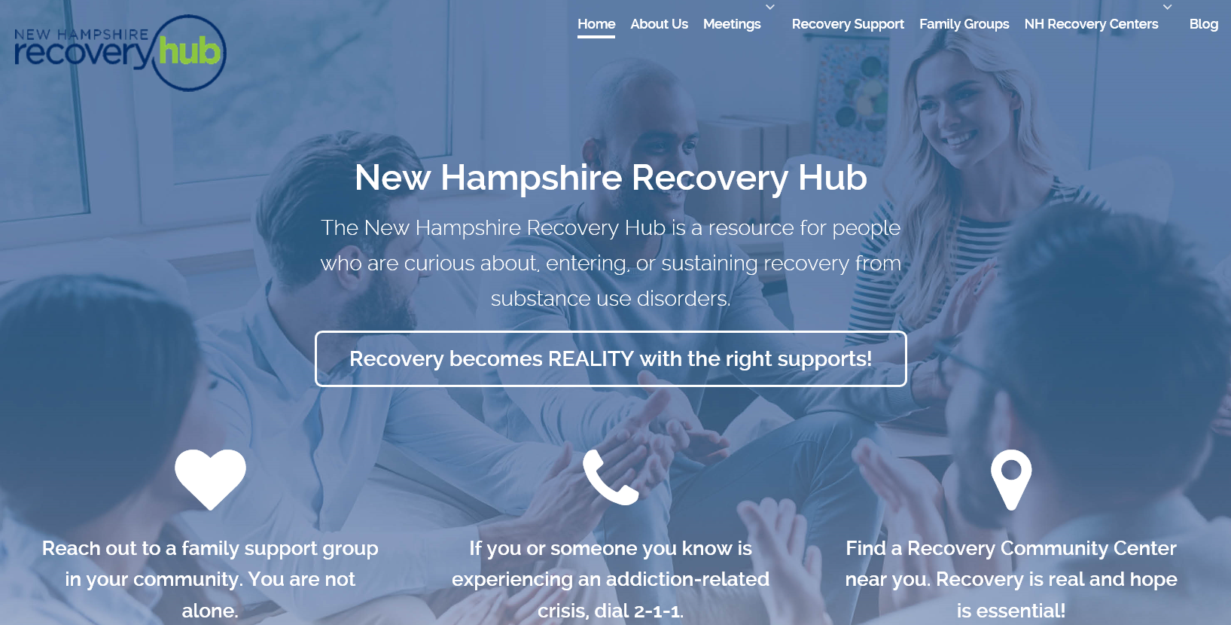
nhrecoveryhub.org

Slide 10
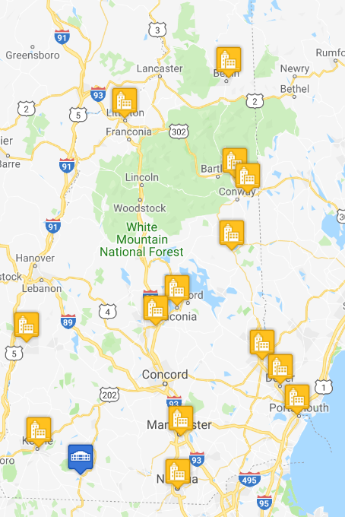
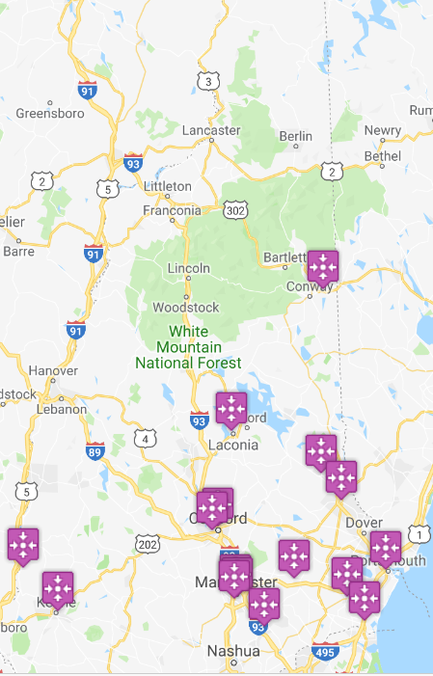
Recovery Centers
Family Support Groups

Slide 11
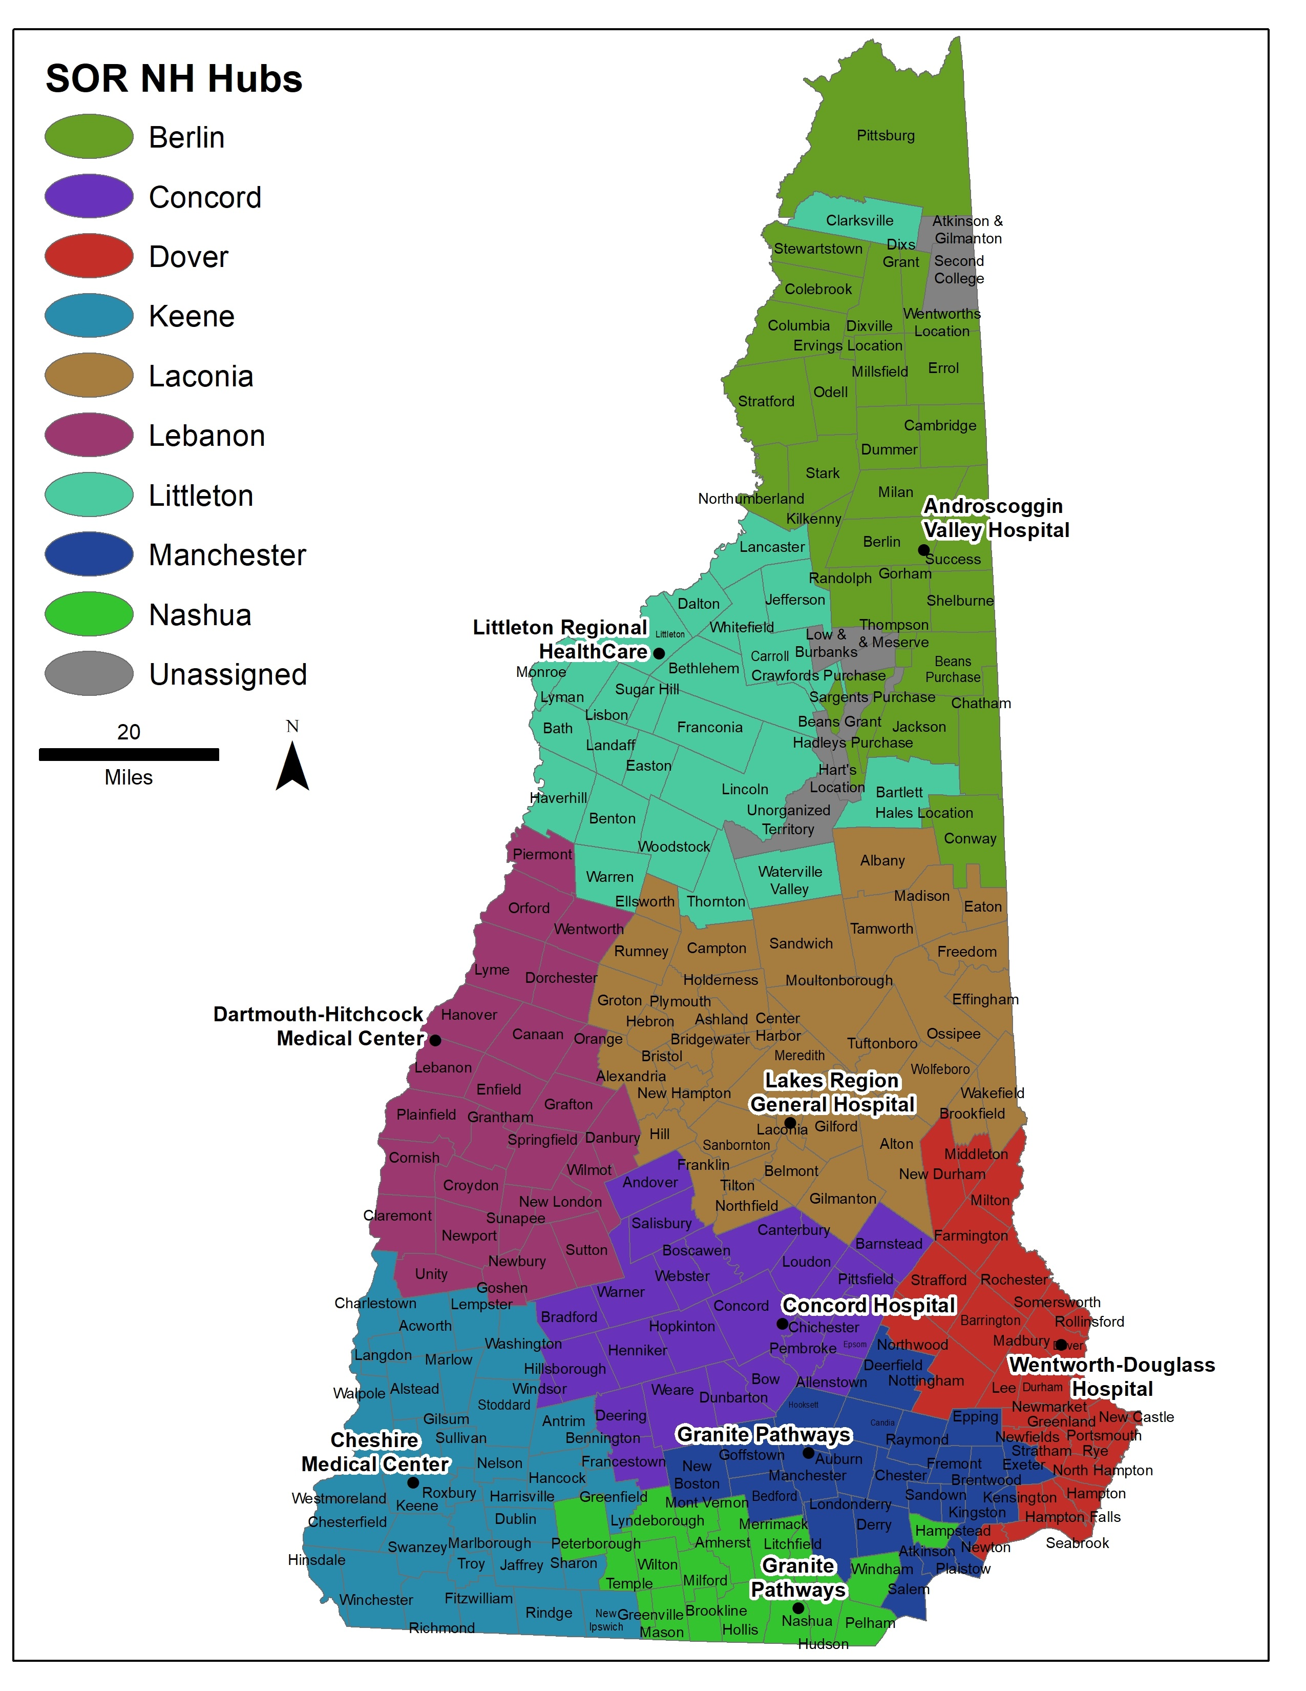
Doorways as Regional Access
thedoorway.nh.gov

Slide 12
System Overview
211
Doorways / On-call
Community Providers
Notes:
The NH Doorways system consists of 3 primary components: 2-1-1, the Doorways and On-Call providers, and service providers in the community. We’ll begin with a brief overview of 2-1-1, the on-call system, and the role of community providers followed by a more in depth discussion of the Doorways both collectively and individually.

Slide 13
Call 2-1-1
24/7 information and referral
Identify need for Doorway services
Warm transfer to Doorways
Connection to emergency services
Notes:
The Doorways system uses 2-1-1 to do what they have already developed a successful model for, providing multilingual information and referral 24 hours a day, 7 days a week. When a client contacts 2-1-1, they will help the client to assess whether or not Doorway services are appropriate and desirable for the client.
Some examples of clients that would not be referred to the Doorways are individuals who are already actively engaged with an SUD treatment or peer recovery support provider or individuals who are only looking for information, not further support. When Doorway services are appropriate for the client, 2-1-1 will help the client choose a Doorway. The initial referral will be to the Doorway that is geographically closest to the client, but client’ will also be able to find out about other Doorways that may be more accessible to them for whatever reason.
During business hours, once the appropriate Hub is identified, 2-1-1 will keep the caller on the line while they contact the Doorway. When the Doorway answers, 2-1-1 will notify the Hub that there is a client on the line seeking services and transfer the call. Outside of normal business hours, with the client still on the line, 2-1-1 will contact the call coverage provider and notify them that there is someone on the line seeking services at whichever Doorway the client has chosen and transfer the call.
In cases where an individual is assessed to be a danger to themselves or others, 2-1-1 will connect the client with the appropriate emergency services providers or contact them directly if needed.

Slide 14
On-Call
Crisis stabilization
Screening and immediate needs assessment
Connection to emergency services when appropriate
Connection to client’s chosen Doorway
Notes:
The call coverage provider will provide a core set of Doorway services outside of normal business hours including crisis stabilization; screening and immediate needs assessment and response as appropriate; and connection to emergency and/or shelter services as appropriate.
Once the client is stabilized, the call coverage provider will determine the best time for the client to come into the Doorway for a live appointment and convey this along with all other information collected to the Doorway of the client’s choice.

Slide 15
Doorways Client Services
Screening and crisis stabilization
Evaluation and care planning
Facilitated referral
Continuous recovery monitoring
Notes:
Doorway services can be broken down into two general groups, direct client services and administrative services. All of the Doorways are currently offering the direct client services.
At the time of initial contact with the Doorway or the on-call provider, an SUD screening is completed. This process gathers the basic information needed to determine how to best address the client’s immediate needs. For clients who are in an acute crisis, screening will include the determination of whether or not to engage the client with emergency services and or a licensed clinician to provide immediate crisis stabilization.
Once a client’s immediate needs are assessed and met, a formal biopsychosocial evaluation used to establish an SUD diagnosis and to determine the initial level of care for the client is completed. The evaluation addresses all American Society of Addiction Medicine, or ASAM, domains and is also used to develop a care plan for addressing other unmet needs that the client may have such as healthcare, mental health services, stable housing, etc.
A facilitated referral process is utilized to help the client to look at the identified service needs and the resources available to help address those needs. In cases where there are barriers to the client accessing these resources, this process includes helping the client to address those barriers such as identifying a payer, obtaining identification, getting medical clearance, etc. This is a highly active process that goes well beyond simply presenting the client with a list of available resources. It is also critical that the client have open choice of service providers and not be restricted to any individual or group of providers.
The final core Hub service is continuous recovery monitoring. Continuous recovery monitoring consists of weekly attempts to contact the client. When client contact is successful, a check in is completed to determine if there are any unmet needs that the client is facing and to assist them in meeting those needs. If a client is already working with a SUD treatment provider, peer recovery support organization, MCO or other entity to address a need, the Hub does not typically become involved in that process.

Slide 16
Community Providers
Clinical and Peer Recovery Support Services
Services to address related concerns
Notes:
Unlike other Hub and Spoke models, the Hubs are not charged with providing treatment services, instead these will continue to be delivered by community providers. The most critical of these spokes are those providing substance use disorder treatment and peer recovery support services. In addition, the Doorways will also need to build relationships with and make referrals to other providers, including but not limited to housing, nutrition, employment and education, domestic and sexual violence, and criminal justice.

Slide 17
The Doorway at…
Adroscoggin Valley: Berlin
Littleton Regional Healthcare: Littleton
Lakes Region General Healthcare: Laconia
Dartmouth-Hitchcock: Lebanon
Concord Hospital: Concord
Granite Pathways: Manchester & Nashua
Wentworth Douglas: Dover
Cheshire Medical: Keene
Notes:
In addition to the core client and administrative services, many of the Doorways also offer other SUD services either on site or nearby; however, these are not a part of the Hub scope of work. Androscoggin Valley, Littleton Regional, Lakes Region. Dartmouth-Hitchcock, and Concord all offer both MAT and Counseling. In addition, Lakes Region and Concord also offer peer recovery support services. It is important to understand that while these services are available to clients, it is still up to the client to select the spoke or spokes that they will access for on-going services.

Slide 18
Raising a concern with substance use
SUD is stigmatized
Make it safe
Your approach makes a difference
Stay with the issue
Reassure
Be honest

Slide 19
Raise substance use in context of issue
Be clear and specific about observations
If general suspicion, raise concerns
Examples:
“Sometimes, situations prevent people from being able to address issues, e.g. health problems / substance use / family issues”
“Help is available. Things can get better”

Slide 20
Asking and Responding
Develop a level of comfort
Be straight-forward and non-judgmental
Make it routine
Make it relevant
Know how to respond
Communicate hope

Slide 21
Provide Resources
211
Doorways: thedoorway.nh.gov
Recovery Centers: nhrecoveryhub.org

Slide 22
THANK YOU
LINDY.KELLER@DHHS.NH.GOV

