Slide 1
Childhood Lead Poisoning in NH:
What Health Officers
Need to Know
October 30, 2019

Slide 2
Beverly Drouin
Section Administrator
Gail Gettens, MS, ECMP
Health Promotion Advisor and
Child Development Specialist
NH Division of Public Health Services
Healthy Homes and Lead Poisoning Prevention Program

Slide 3
New Hampshire 2012 – 2017
Average of over 800 children annually with an elevated blood lead levels (EBLL) greater than 5 µg/dL.
Fewer than 17% of children under 6 years
in NH have had a blood lead level test.

Slide 4
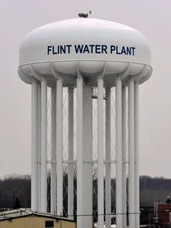
508

Slide 5
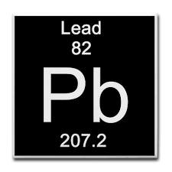
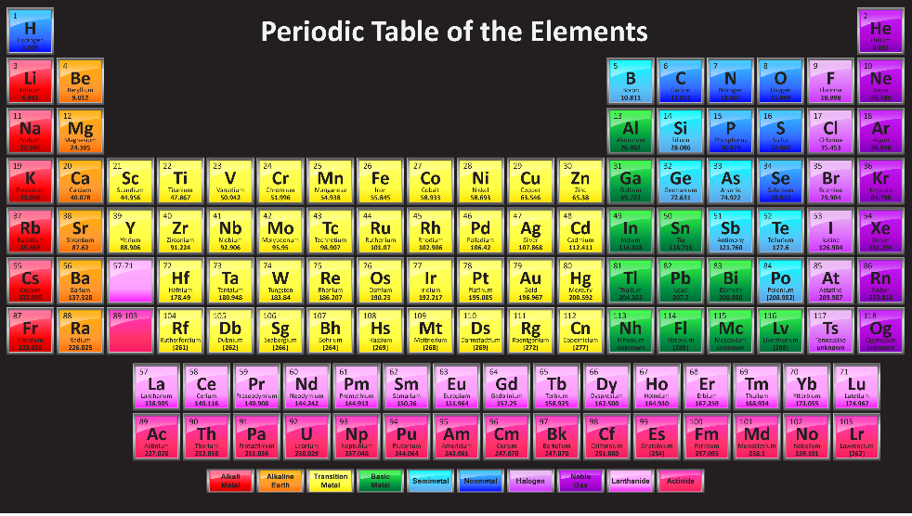
What is Lead?
What is its source?
How is it used?

Slide 6
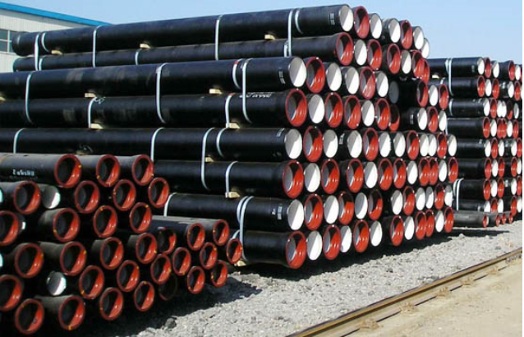
How Are NH Children Being Poisoned?
In NH children are almost always poisoned by dust from deteriorating or disturbed old lead paint.

Slide 7
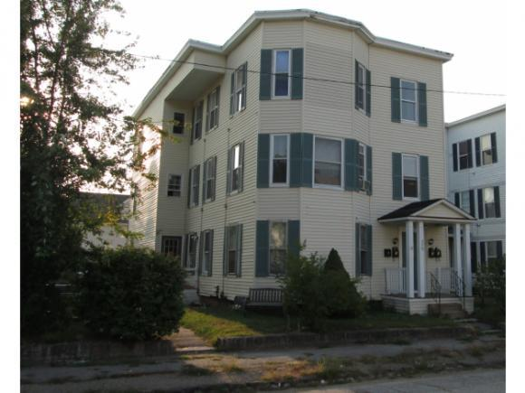
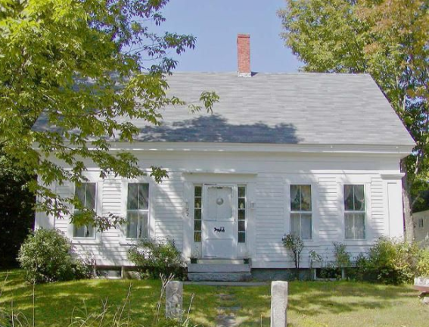
62% of New Hampshire’s housing stock was built before lead in residential paint was banned.
1 in 3 NH children with EBLL’s report renovations within past 6 months.

Slide 9
Perfect Storm
Don’t See Deficits and Impact Until Older
No Brain-Blood Barrier
Developing Brain
Sweet Tasting
Trace Amounts
No Immediate
Symptoms
Oral Stage
Crawl on Floors and Pull to Standing - Surfaces Where Lead Dust Collects
Perfect Pediatric Poison
Potent Neuro-Toxicant

Slide 10
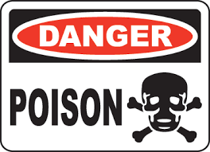
How Much Lead Does It Take To Poison A Child?
Demonstration
Lead’s exposures negative impact on a child’s developing brain is irreversible. There is no cure. There is no treatment.

Slide 13
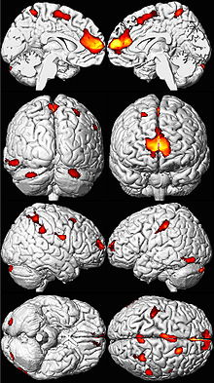
Source: Dr. Kim Cecil
Cincinnati Lead Study
Male Child
EBBL 13.8

Slide 14
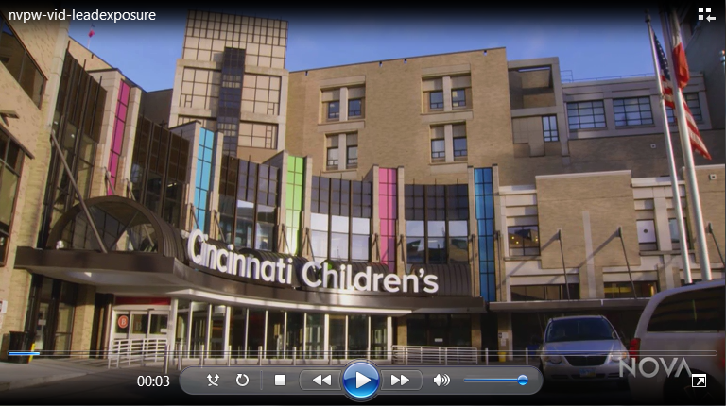

Slide 15
Lead Exposure’s Negative Impact On Specific Abilities
Lower IQ - Lower or failing test scores
Poor school performance and achievement
Behavior problems
These effect persist, from childhood through adulthood

Slide 16
NH Legislative Updates: Childhood Lead Poisoning
Senate Bill SB247
Signed into law by Gov. Sununu on February 8, 2018
Universal BLL Testing of NH Children – effective April 9, 2018
Notes:
Active legislative action for last three years – District 15 – NH State Senator Dan Feltes taking the lead on addressing this pediatric public health issue.

Slide 18
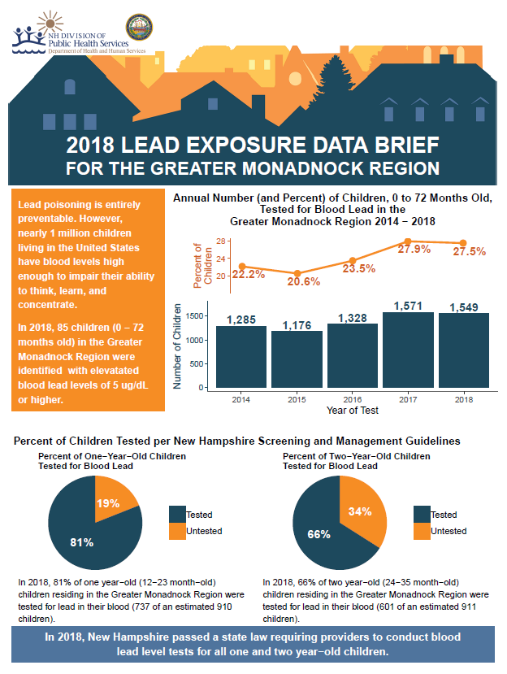
Notes:
The RRP Rule governs activities in pre-1978 housing and child occupied facilities, where paint is disturbed. Why 1978? That’s when lead paint was officially banned for residential use.

Slide 19
Regional Lead Exposure Data
Testing rates for the entire region
Breakdown of 1 year olds and 2 year olds
Notes:
The RRP Rule governs activities in pre-1978 housing and child occupied facilities, where paint is disturbed. Why 1978? That’s when lead paint was officially banned for residential use.

Slide 20
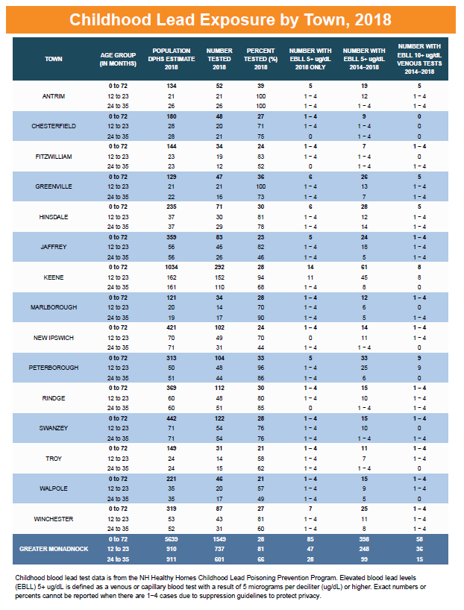
Town level numbers
Lead testing rates
Lead exposures
Notes:
The RRP Rule governs activities in pre-1978 housing and child occupied facilities, where paint is disturbed. Why 1978? That’s when lead paint was officially banned for residential use.

Slide 21
Notes:
The RRP Rule governs activities in pre-1978 housing and child occupied facilities, where paint is disturbed. Why 1978? That’s when lead paint was officially banned for residential use.

Slide 22
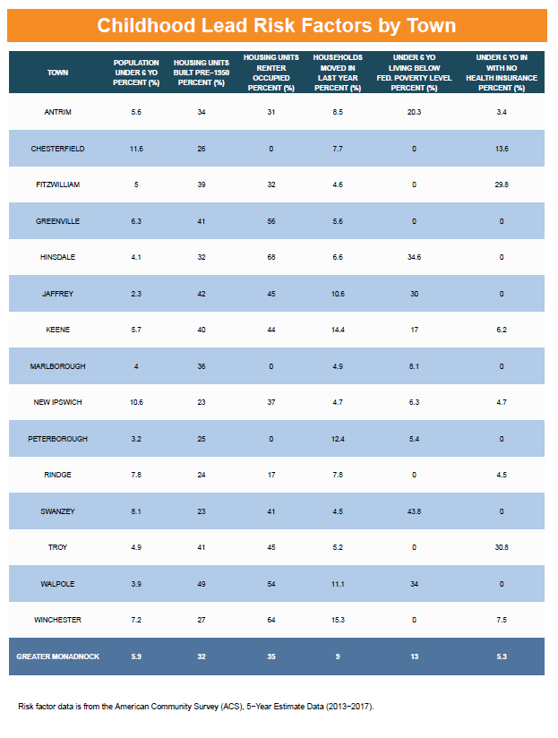
Town level numbers
Housing risk factors
Socioeconomic risk factors
Notes:
The RRP Rule governs activities in pre-1978 housing and child occupied facilities, where paint is disturbed. Why 1978? That’s when lead paint was officially banned for residential use.

Slide 23
Notes:
The RRP Rule governs activities in pre-1978 housing and child occupied facilities, where paint is disturbed. Why 1978? That’s when lead paint was officially banned for residential use.

Slide 24
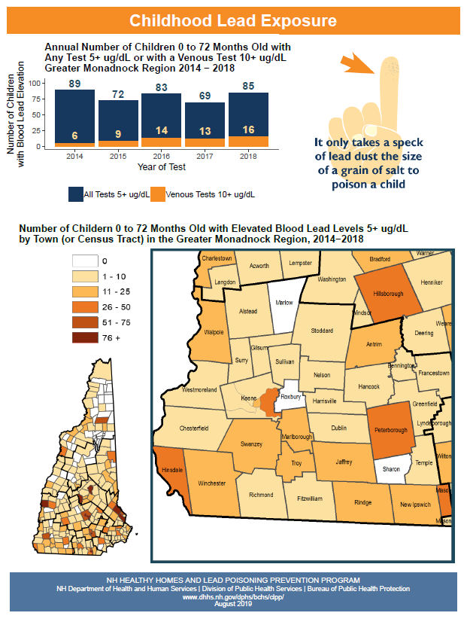
Time trend of lead exposure
Map of lead exposure by town
Notes:
The RRP Rule governs activities in pre-1978 housing and child occupied facilities, where paint is disturbed. Why 1978? That’s when lead paint was officially banned for residential use.

Slide 25
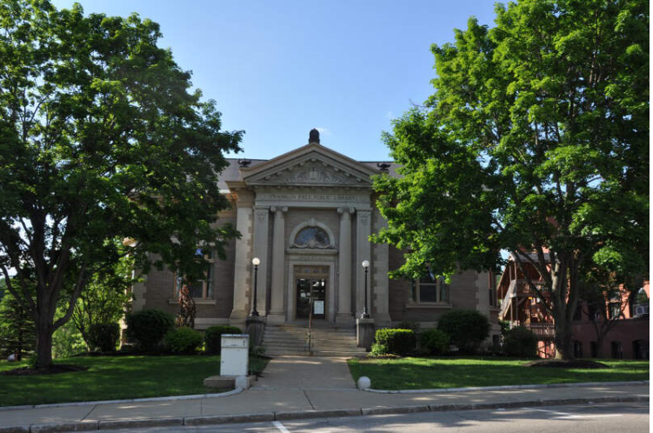
Winnipesauke Region Public Health Network
5 yr. average – 305 new children annually with BLL 5 µg/dL or higher
61 new children with EBLL’s – 2014 – 2018
Under reported – very low testing rates in many communities in Winnipesauke PHN
Notes:
Gail

Slide 26
Thank You
Notes:
The RRP Rule governs activities in pre-1978 housing and child occupied facilities, where paint is disturbed. Why 1978? That’s when lead paint was officially banned for residential use.

